Slide 1
Data Management Assignment One Ethical concerns with Anti-Money Laundering systems
Ciaran Finnegan – TU060
Std No: d21124026

Slide 2
What is Anti-Money Laundering (AML)?
Anti-Money Laundering (AML) systems are typically an integrated set of processes and automated system to detect, prevent, and report criminal activity in a financial network. Focus is on transaction monitoring and name screening.
Thus, a major characteristic of AML systems is the use of various internal and external WATCH LISTS. These are data stores that identify specific individuals or companies and are used to influence decisions made by financial institutions.

Slide 3
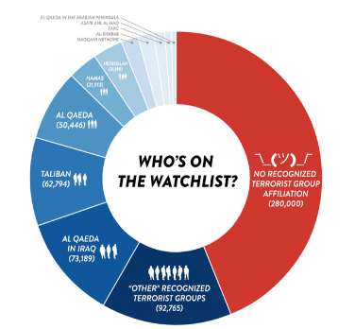
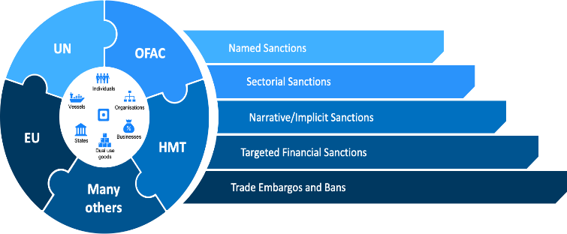

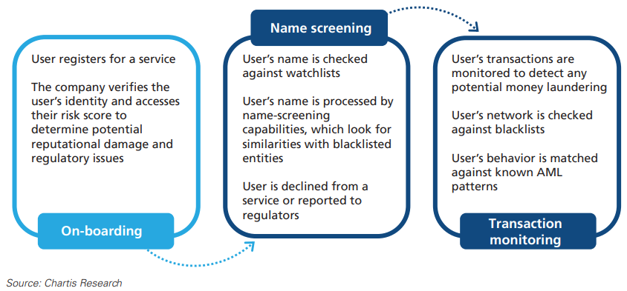
The AML Process
Watch List Management (WLM) systems draw in data elements from published watch lists to identify potentially criminal actors using the services of a Financial Institution (FI).
If data is poorly analysed, then an innocent customer may be denied a service or criminal activity could be left undetected.

Slide 4
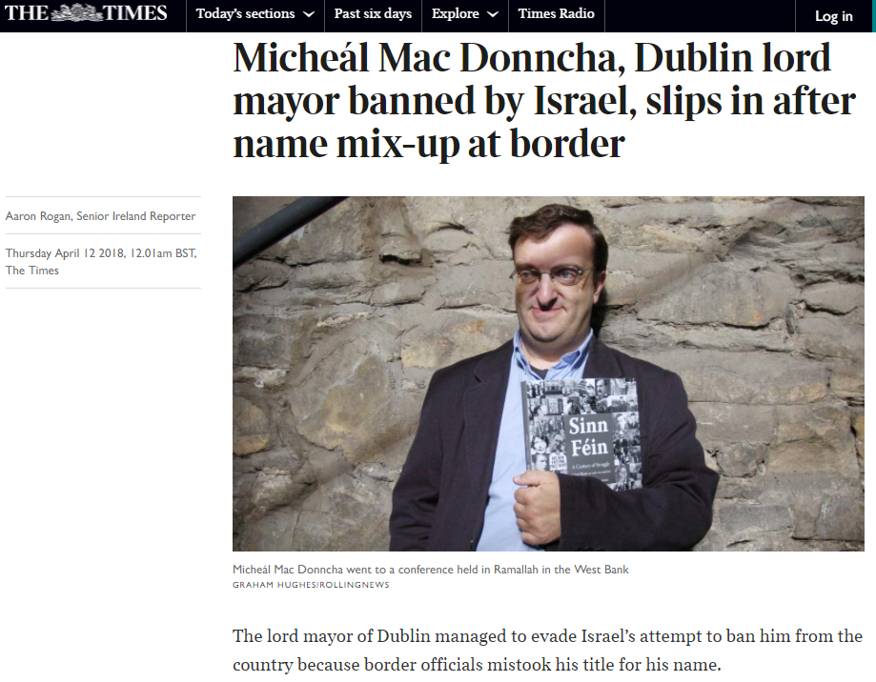

WLM Name Screening Challenge
GDPR legislation recognises the right of individuals to be recorded in data stores with recognised titles and/or ethnic name spellings.

Slide 5
AML/WLM – Critical Issues
Ethics...
Data Governance…
Data Privacy…

Slide 6

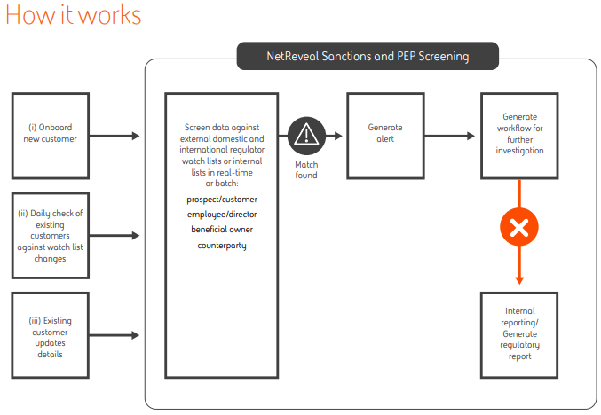

BAE Digital Intelligence NetReveal
The BAE D.I. NetReveal (NR) AML/WLM solution is one of the key vendor offering in this Compliance space for FIs.
Market presence is significant in the EMEA and Asia Pacific regions.
NR name screening processes face all the key challenges with modern AML/WLM systems.

Slide 7
BAE Digital Intelligence NetReveal
Data Governance
Blah...
Slide .. Highlighting any areas for concern or examples of good practice.

Slide 8
BAE Digital Intelligence NetReveal
Data Privacy
Blah...
Slide .. Highlighting any areas for concern or examples of good practice.

Slide 9
BAE Digital Intelligence NetReveal
Data Ethics
Blah...
Slide .. Highlighting any areas for concern or examples of good practice.

Slide 10


BAE Digital Intelligence NetReveal
Good Practice
Blah...
Slide .. Highlighting any areas of good practice.

Slide 11

BAE Digital Intelligence NetReveal
Concerns
Blah...
Slide .. Highlighting any areas of good practice.

Slide 12
References
...
…
…

